Slide 1
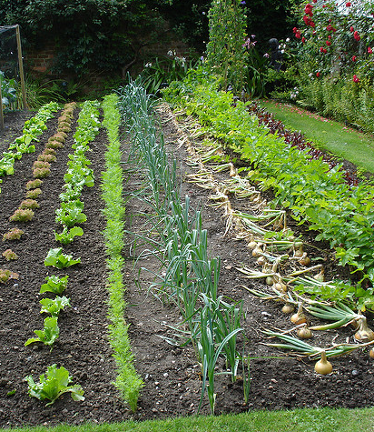
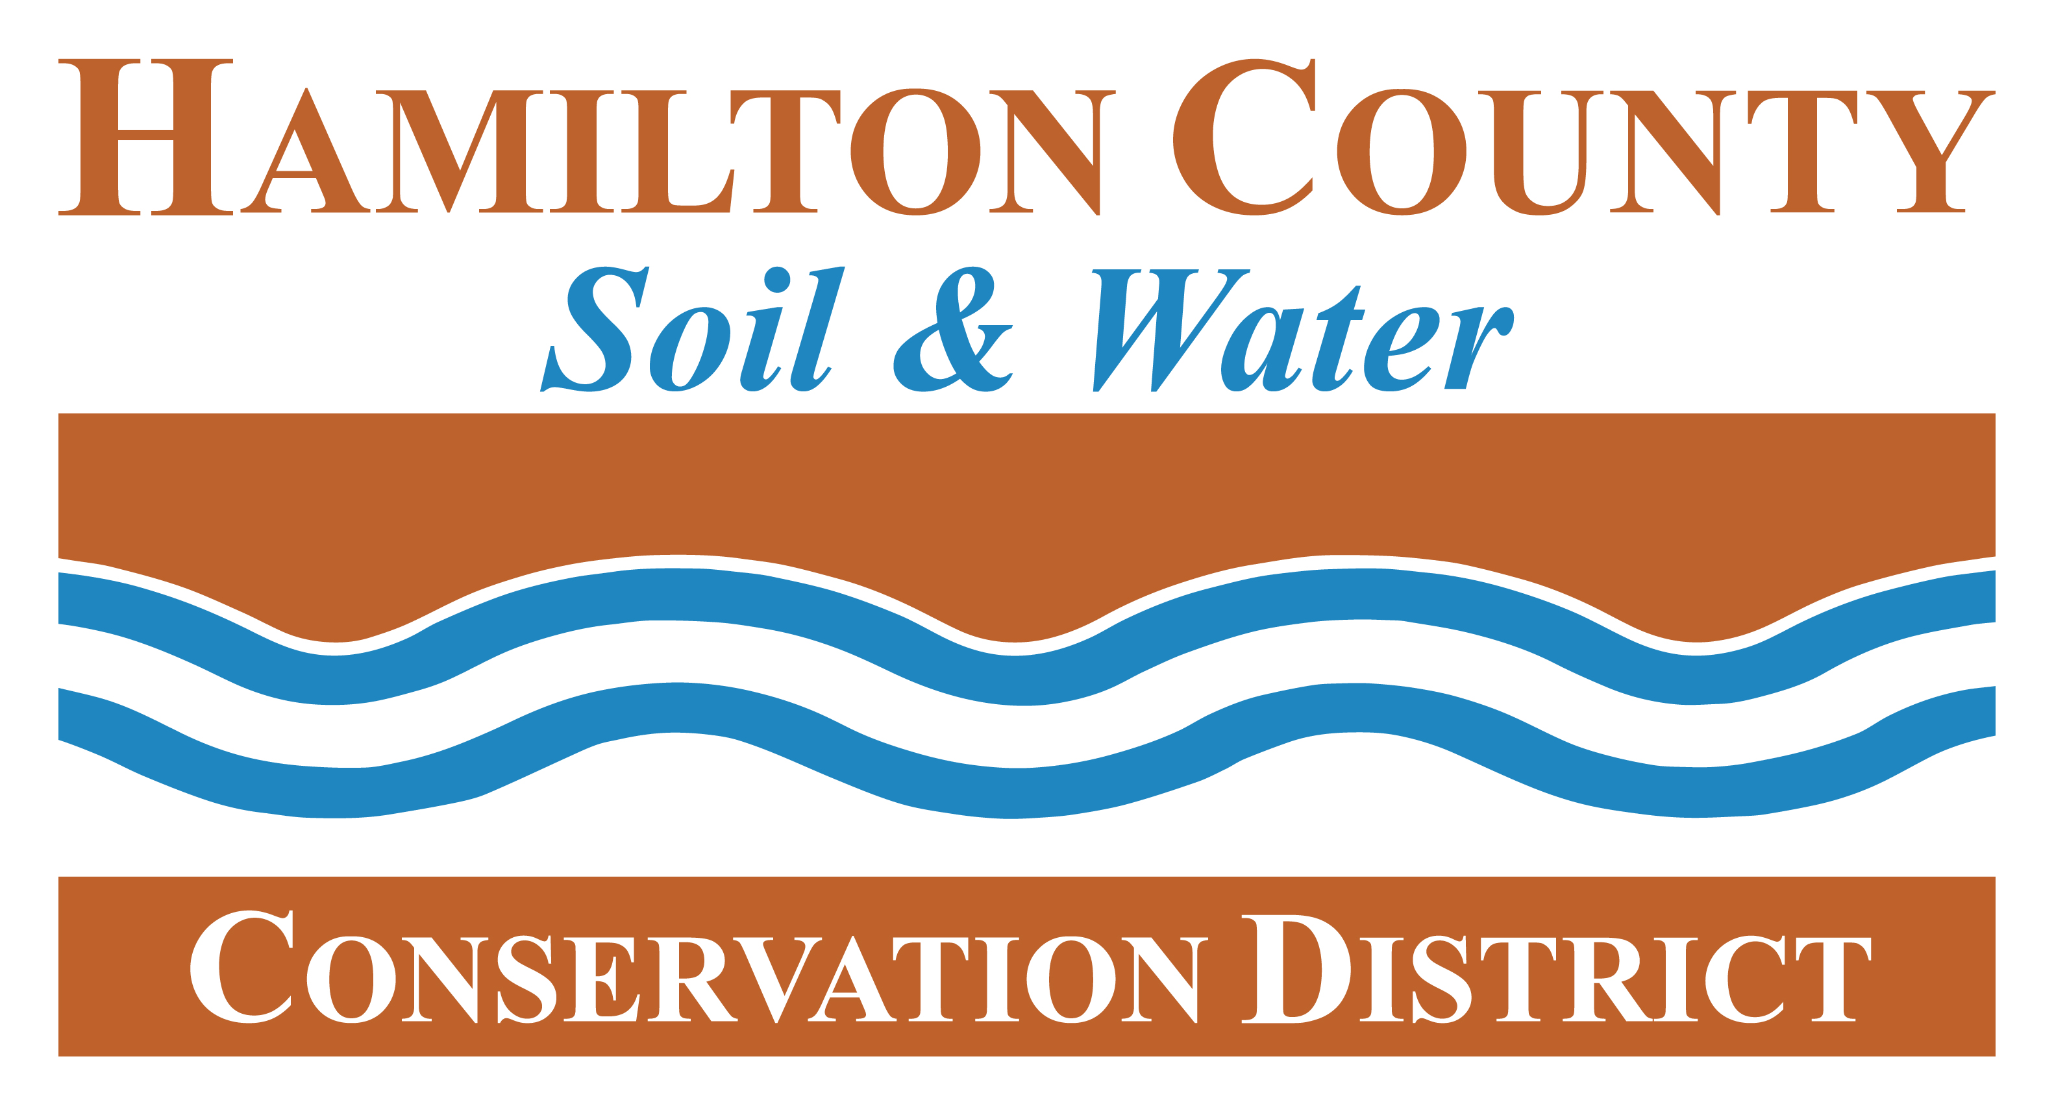
Climate Change in the Garden
Cultivating an Ecologically Intelligent Garden

Slide 2
Our Time Today
Importance of this discussion and how Community Gardens (and gardens) play a role?
What Impacts is it having in Central Indiana?
How to Adapt in the Garden and Elsewhere?
Notes:
Engaging Today
It’s okay to question the validity of climate change and the role humans play. However, this is not the appropriate setting to have a conversation about that particular point. I’m not saying that that conversation is not important. But I can assure you that nothing will change or that the solutions will be derailed if we go down that path.
This conversation today needs to focus on how to adapt to the reality of a more uncertain climate.
However, here is what I promise to do my best at:
My goal is to meet you where you are. You can help me know where you are by asking questions of curiosity.
I’m going to be sharing a lot of facts. That being said, my relationship to you is more important than the facts I’m sharing.
The goal is to share this information through a presentation and hopefully through conversation
I understand that it is a strange power dynamic with my standing up here and casting information at you. But my focus is on you as an individual.

Slide 3
Solastalgia
Solastalgia is a neologism that describes a form of psychic or existential distress caused by environmental change, such as mining or climate change.
Coined by philosopher Glenn Albrecht in 2003, it was formed from a combination of the Latin word solacium (comfort) and the Greek root –algia (pain).”
This Photo by Unknown Author is licensed under CC BY-NC-ND
Notes:
Engaging Today
It’s okay to question the validity of climate change and the role humans play. However, this is not the appropriate setting to have a conversation about that particular point. I’m not saying that that conversation is not important. But I can assure you that nothing will change or that the solutions will be derailed if we go down that path.
This conversation today needs to focus on how to adapt to the reality of a more uncertain climate.
However, here is what I promise to do my best at:
My goal is to meet you where you are. You can help me know where you are by asking questions of curiosity.
I’m going to be sharing a lot of facts. That being said, my relationship to you is more important than the facts I’m sharing.
The goal is to share this information through a presentation and hopefully through conversation
I understand that it is a strange power dynamic with my standing up here and casting information at you. But my focus is on you as an individual.

Slide 4
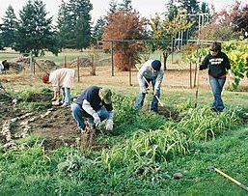
Importance of Community Gardens and Green Infrastructure
Community gardens are green infrastructure
Climate change presents opportunities to promote urban green infrastructure and community gardens.
Community gardens can play a critical role in anticipating potential impacts.
Unlike human-built "gray infrastructure," green infrastructure can be conducive to grassroots stewardship and governance, and has the potential to relieve climate change-related strains on municipal budget, and improve overall human health.
Notes:
Community gardens, like forests and native areas, are GREEN INFRASTRUCTURE.
The importance of maintaining green infrastructure to support those benefits will likely increase in a changing climate.

Slide 5
What is Climate Change Doing in Central Indiana?
Notes:
Pulled out relevant information from several reports published by the Indiana Climate Change Impacts Assessments
Purdue University’s Center for Climate Change
Work with lots of scientists and local leaders around Indiana
Broadly speaking – the ran projections based on two different scenarios: A scenario with medium greenhouse gas emissions and another with “high” greenhouse gas emissions.

Slide 6
Rising Temperatures, Worse Air, More Pests and Invasives
Notes:
Key finding: Indiana has already warmed 1.2°F since 1895. Temperatures are projected to rise about 5°F to 6°F by mid-century¹, with significantly more warming by century’s end.
Why it matters: A rising average temperature increases the chance of extreme heat and reduces the chance of extreme cold, and it also changes the timing and length of the frost-free season when plants grow. These shifts will impact air quality, extend the growing season and the allergy season, and create more favorable conditions for some pests and invasive species.

Slide 8
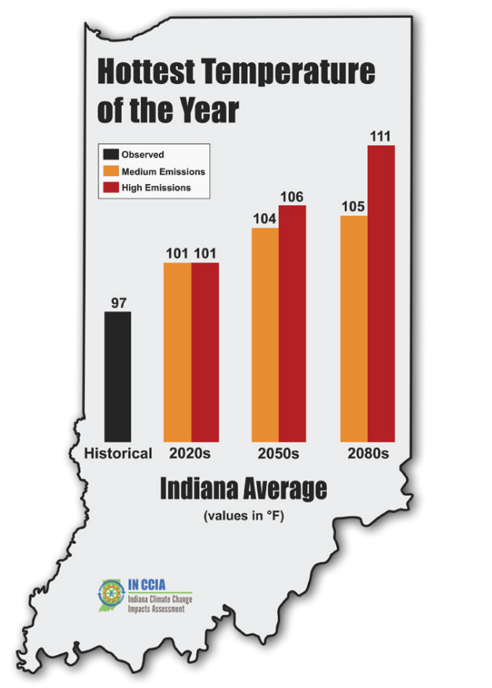
More Hot Days
Notes:
Key finding: The number of extremely hot days (over 95 degrees) will rise significantly in all areas of the state. In the past³, southern Indiana averaged about seven of these days per year, but by mid-century this region is projected to experience 38 to 51 extremely hot days per year.
Why it matters: Extreme heat raises the likelihood of heat-related illnesses, such as heat exhaustion and heat stroke, which can lead to increased hospitalizations and medical costs. Children and the elderly are especially vulnerable. Extreme heat also reduces crop yields, counteracting the benefits of a longer growing season.

Slide 10
Heat Stress on Urban Plants
Warming temperatures are expected to increase heat stress on urban plants and may result in additional pressure from pests and diseases. Plant heat stress days—with temperatures reaching above 86°F—in central Indiana are projected to increase by 6.5 to 8 weeks by mid-century¹. Elevated temperatures within urban areas (urban "heat islands") may further exacerbate the impacts of climate change.
A warmer, longer growing season with higher levels of atmospheric carbon dioxide (CO₂) may promote tree growth and carbon storage in Indiana’s urban green spaces. However, excessive heat stress may lead to carbon storage reductions in trees and increased CO₂ emissions from soil. Damage from extreme weather events to trees, and reduced snow cover on lawns can also lead to carbon losses.

Slide 12
Longer Growing Season…maybe?
Notes:
Key finding: The frost-free season has lengthened by nine days per year statewide since 1895. This trend is projected to continue and intensify. By mid-century, central Indiana’s frost-free season is projected to increase by 3.5 to 4.5 weeks compared to the past³.
Why it matters: Longer growing seasons can increase the productivity of food crops and forests, and could expand crop-production opportunities in northern latitudes or the possibility of double-cropping further south. But they also increase growth of less desirable plants like ragweed and create favorable conditions for some invasive species.
-------
Key finding: While Indiana’s frost-free season is expected to start about one month earlier by mid-century, average crop planting dates are not expected to significantly shift due to increased spring rainfall limiting early access to fields. Observations over the last 30 years show a declining number of days suitable for spring fieldwork in Indiana, and this trend is expected to continue. Coping with change: Improving soil health with management practices that increase soil stability and water movement can help with managing additional spring rainfall. Fall-planted cereal crops that continue growing into early spring can aid in extracting excess soil water, potentially providing earlier field access. Investing in additional subsurface drainage and machinery suitable for wetter conditions may also improve field accessibility.

Slide 14
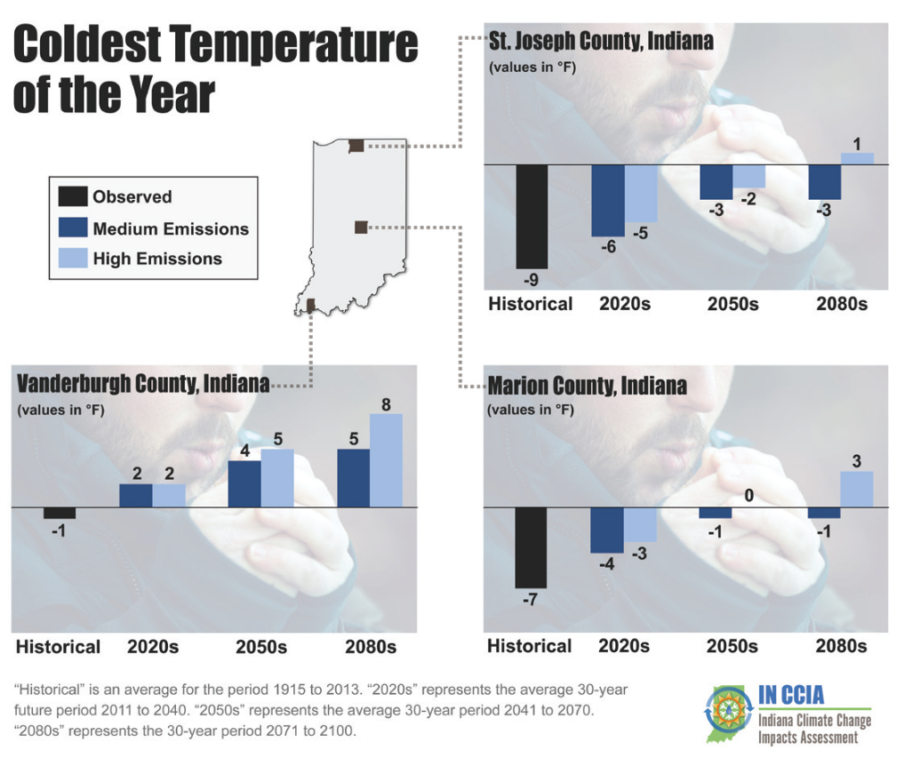
Fewer Cold Days
Notes:
Key finding: Extreme cold events are declining. By mid-century, the northern third of Indiana will experience on average only six days per year below 5°F, down from 13 days in the past.
Why it matters: Cold temperatures control populations of disease-carrying insects such as mosquitoes and ticks, as well as forest pests. Warmer winters would allow some of these species to remain active for longer periods or to expand their ranges into Indiana.
This puts Indiana at risk for some invasive species and insect pests that historically would not survive Indiana’s coldest winters.

Slide 16
Warmer Overnight Temperatures (Corn)
Key finding: Warmer overnight temperatures in Indiana have contributed to reduced corn yields over the last decade. Elevated overnight temperatures increase plant respiration, reducing sugar availability for grain production, and can affect the timing and success of pollination—resulting in lower crop yield. Observations show that Indiana corn yields are reduced by about 2 percent for every 1°F increase in overnight temperatures during July. Coping with change: Earlier planting or using varieties that more quickly reach maturity could help corn plants avoid summer heat stress during pollination. Breeding corn for traits that improve factors contributing to yield in warmer conditions may also help offset the effect of warming overnight temperatures.

Slide 17
Increased Rates of SOM Decomposition
Key finding: Warming temperatures have the potential to increase rates of soil organic matter decomposition in Indiana by about 50 percent by mid-century, which can reduce infiltration and soil water holding capacity and increase the release of carbon dioxide and nitrogen gases from the soil into the atmosphere. Coping with change: Adopting management practices that improve overall soil quality, such as increasing plant diversity and use of cover crops and reduced/no-till systems, can help maintain soil organic matter even as temperatures warm.

Slide 18
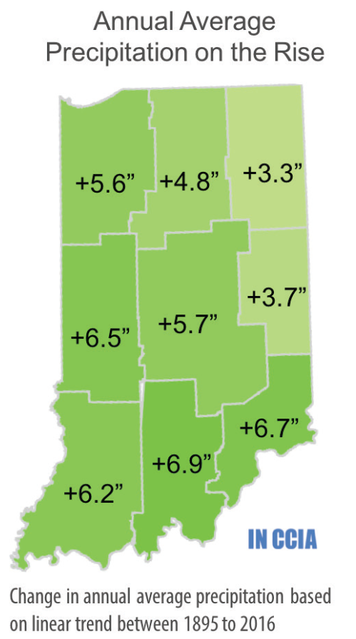
More Precipitation and at the Wrong Time
Notes:
Key finding: Average annual precipitation has increased 5.6 inches since 1895, and more rain is falling in heavy downpours. Winters and springs are likely to be much wetter by mid-century, while expected changes in summer and fall precipitation are less certain.
Why it matters: Increased precipitation, especially in the form of heavy rain events, will increase flooding risks and pollute water as combined sewer systems overflow and fertilizers run off of farm fields [and lawns]. Warmer summers with the same or less rain would increase stress on agricultural crops and drinking water supplies.

Slide 19
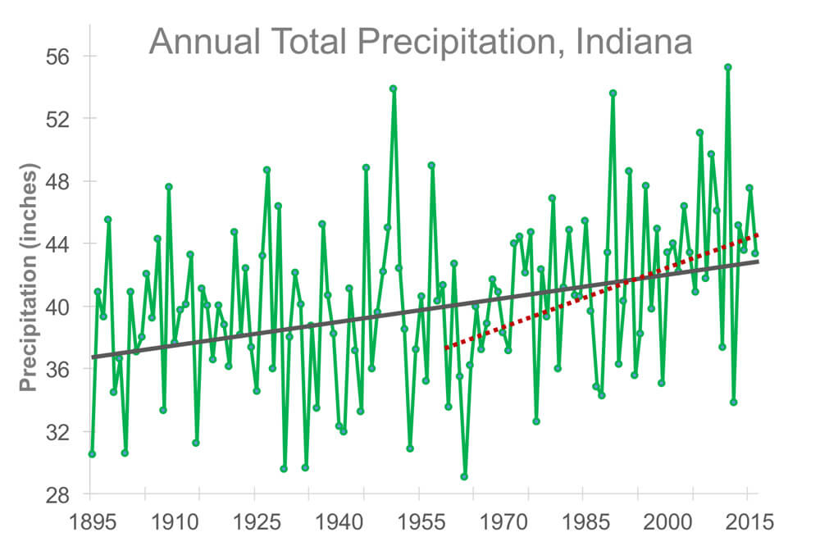

Slide 20
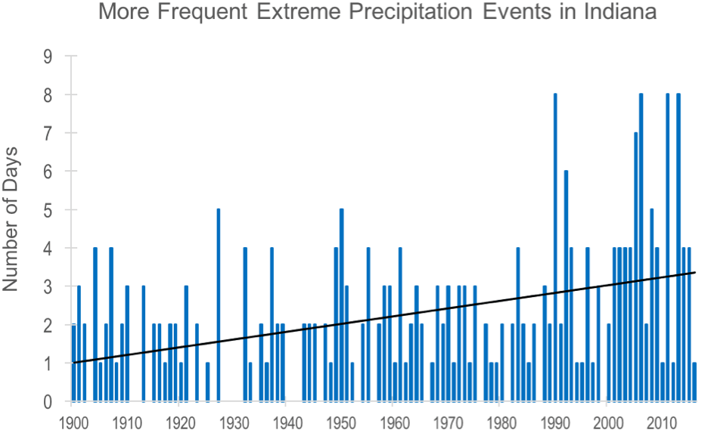

Slide 21
Precipitation and Nutrient Loss
Key finding: Increasing winter and spring precipitation will result in about a 30 to 50 percent increase in spring subsurface tile drainflow in Indiana by mid-century. These shifts will likely lead to nutrient loss from farm fields, and some existing drains may be overwhelmed by the higher flows. Coping with change: Implementing in-field and edge-of-field conservation practices can reduce nutrient losses. Capturing drainflow during the non-growing season could become more effective as the timing of peak drainflow is projected to occur earlier in the winter and spring. Increased use of winter cereal crops, like rye, that capture nutrients and transpire water may help with managing water-stressed fields.

Slide 22
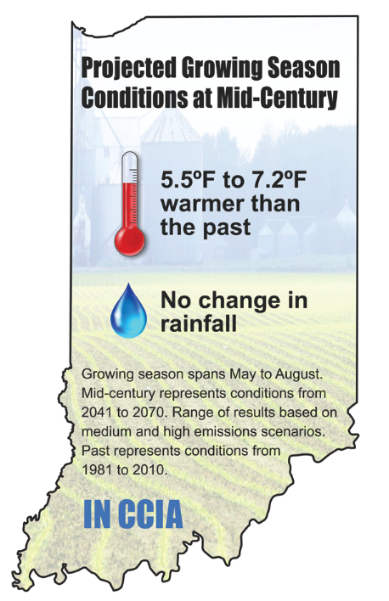
Heat Stress and Water Deficits
Notes:
Key finding: More frequent heat stress and a doubling of water deficits are expected to reduce Indiana corn yields, for current varieties, by 16 to 20 percent by mid-century. Soybean yields are expected to decline 9 to 11 percent. Increasing atmospheric carbon dioxide may lessen yield losses in soybeans, and double-cropping of soybeans will become increasingly viable in southern Indiana.

Slide 23
Increased Pest and Disease Pressure
Key finding: Warmer winters, wetter springs and hotter summers may result in increasing weed, pest and disease pressure on Indiana’s agricultural production. These indirect influences are complex, difficult to predict and can be positively or negatively affected by farm management decisions. Coping with change: With no change to current cropping systems, producers of all crops will likely need to increase foliar pesticide and herbicide applications, increasing the risk of pesticide resistance. Pest disease damage may be reduced by selecting plant species with increased insect and disease resistance.

Slide 24
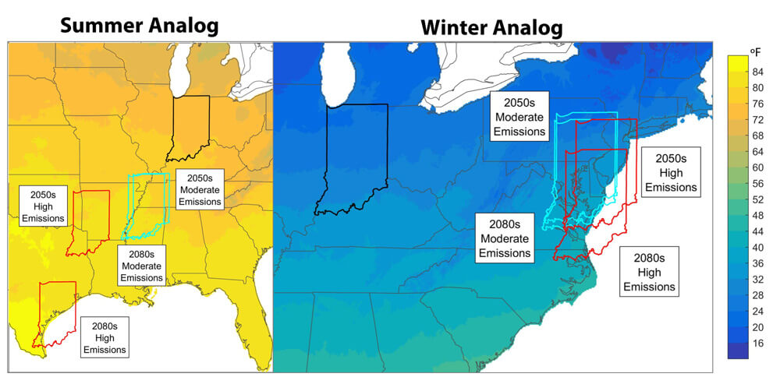
Plants are Migrating

Slide 25
Biodiversity Loss

Slide 26
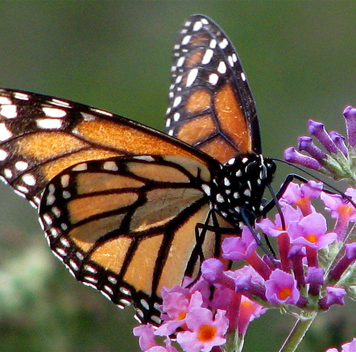
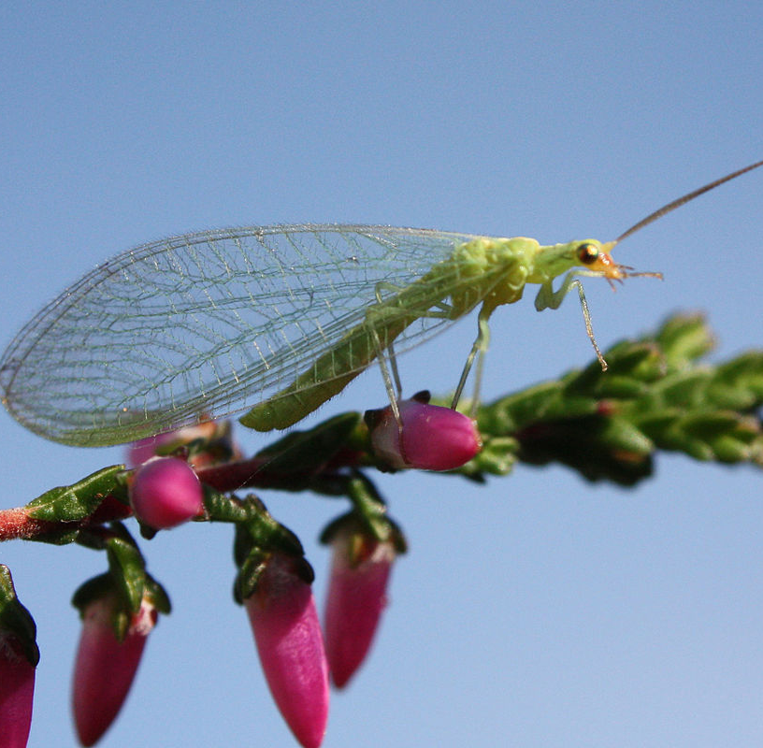
Defaunation: 41% Reduction in Insect Populations in last 10 years
Insects are critical to food production. There is no food without them.
At the current rate, some scientists are weary saying insects could become extinct by 2100.
350,000 species are in decline worldwide.
This Photo by Unknown Author is licensed under CC BY
This Photo by Unknown Author is licensed under CC BY-SA

Slide 27
Distilling the Information
Hotter summers with current to lower amounts of precip. will stress ALL plants in and out of the garden.
Loss of native biodiversity will increase pest pressure.
SOM and nutrients will be lost through lack of snow cover in the winter, warmer winter temperatures, hotter summer temperatures, and increased rain and runoff in the winter and spring.
Soil will lose its capacity to hold nutrients and moisture.
Native biodiversity of beneficial insects and beneficial plants will decrease – threatening the food chain and crop production.
Native biodiversity will change
Invasives will increase.

Slide 30
The Ecologically Intelligent Garden will…
PROTECT by removing invasive species and slowing water down to recharge the aquifer and reduce erosion and nutrient loss…
ENHANCE by capturing/storing as much carbon and sunlight as possible and putting it in the ground – building SOM and improving soil health,
ENHANCE biodiversity and native areas that act as a “life trust”, improves resiliency and restores the food chain balance,
ADAPT by looking ahead to add beneficial plants, employing thoughtful technology, and seed varieties.

Slide 31
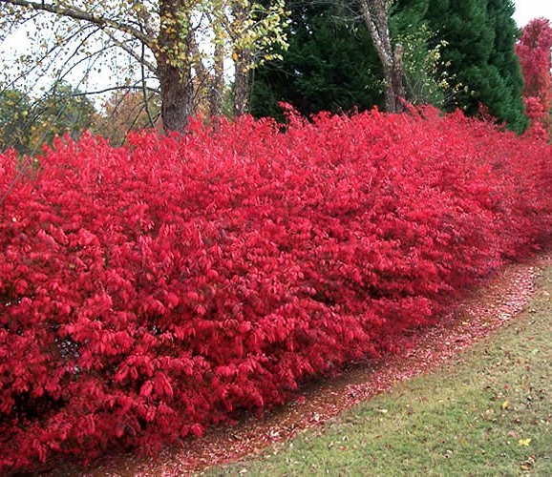
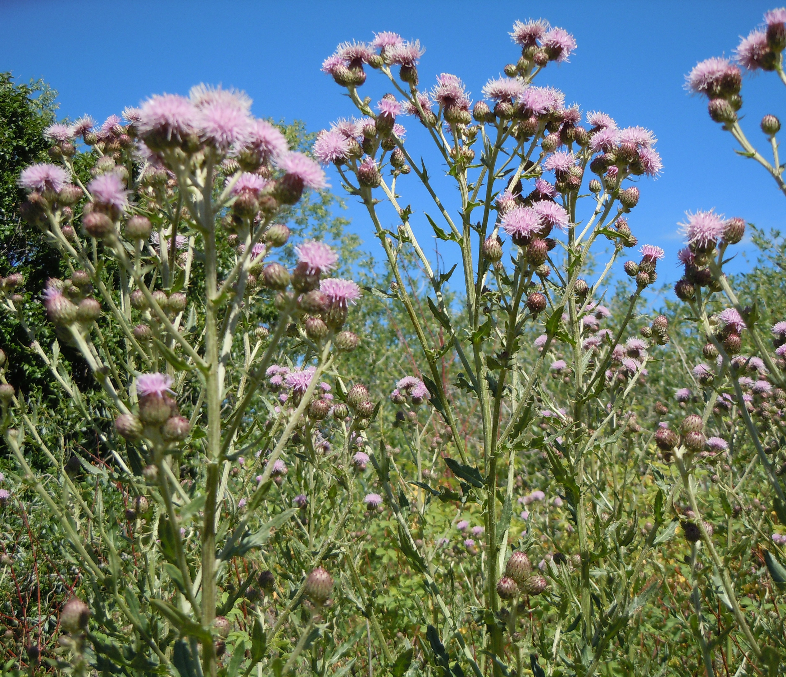
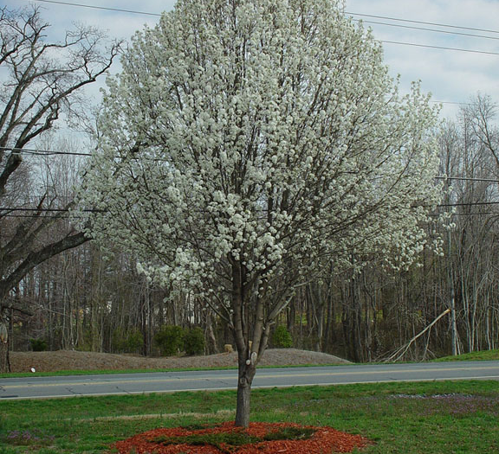
PROTECT: Remove Invasive Species
Honeysuckle
Canada thistle
Chinese privet
Tree of Heaven
Norway Maple
Callery Pear
Burning Bush
…many others
Notes:
Invasive species provide no larval or insect habitat and spread proliferously while crowding out native plants that do.

Slide 32
PROTECT: Convert Lawn to Natives
This Photo by Unknown Author is licensed under CC BY-NC-ND
Notes:
Turf grass, when mowed, makes it very difficult for water to percolate through the ground because the roots spread horizontally due to mowing.
Consider mowing grass higher during the warmer months, and maybe 4” for June/July, to keep soil moisture in the ground from evaporating and create beneficial insect habitat and reduce Japanese beetles.
By reducing mowing you reduce emissions AND allow the roots to penetrate deeper into the ground – storing more carbon and improving soil porosity for water.
You can do this aesthetically using strong lines and borders that make order of the chaos.

Slide 33
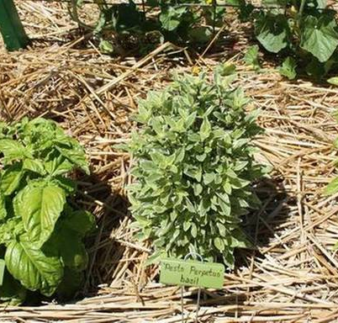
PROTECT/ENHANCE: Keep your soil covered
Limits evaporation
Provides cover for beneficial insects
Reduces fungal diseases in tomatoes
Adds organic matter
Reduces weed pressure

Slide 34
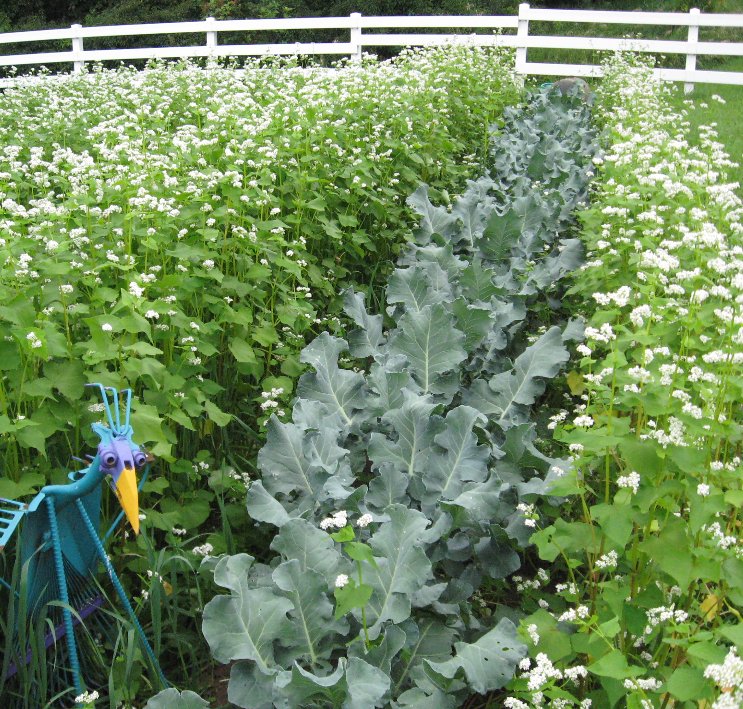
ENHANCE: Summer Intercropping w/ Cover Crops
Builds SOM
Pulls carbon out of the air
Is a pollinator and beneficial insect haven
Reduces weed pressure
Cools soil temperature dramatically in the summer (warms it in the spring)
Limits evaporation
Notes:
This is in addition to Fall/Winter cover cropping

Slide 35
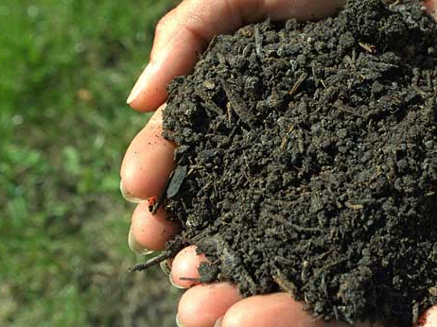
PROTECT: Limit tilling to top 2”
The more the soil is disturbed, the more organic matter decomposes as CO2.
The fungi, bacteria, and other microbes in the soil is what delivers nutrients to roots…AND
They are the communication system between plants that helps share resources or protect them in time of stress.
THE SOIL IS THE IMMUNE SYSTEM OF YOUR PLANT

Slide 36
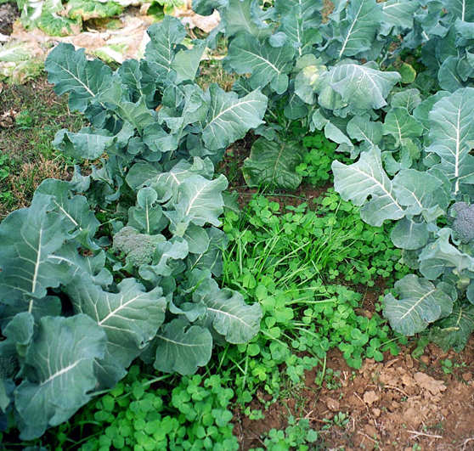
ENHANCE: Summer Intercropping w/ Cover Crops

Slide 37
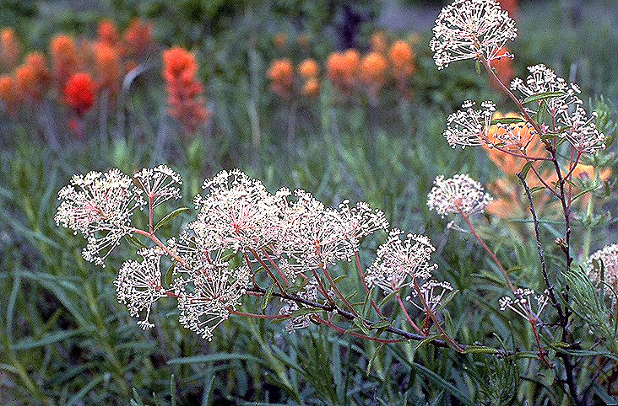
ENHANCE/ADAPT: Anticipating Changes in Biodiversity

Slide 38
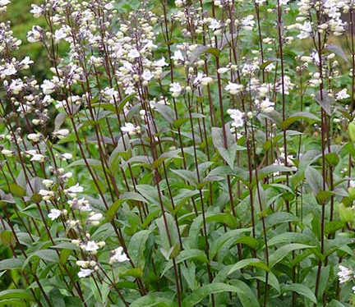
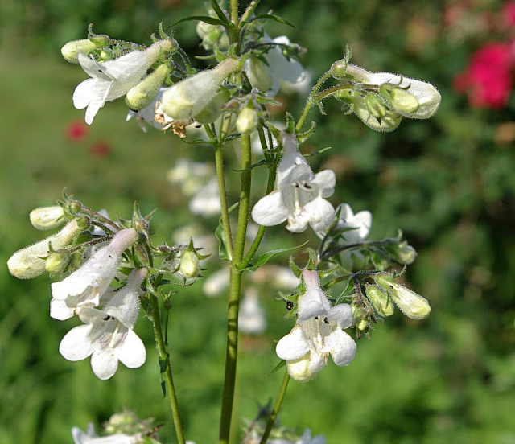
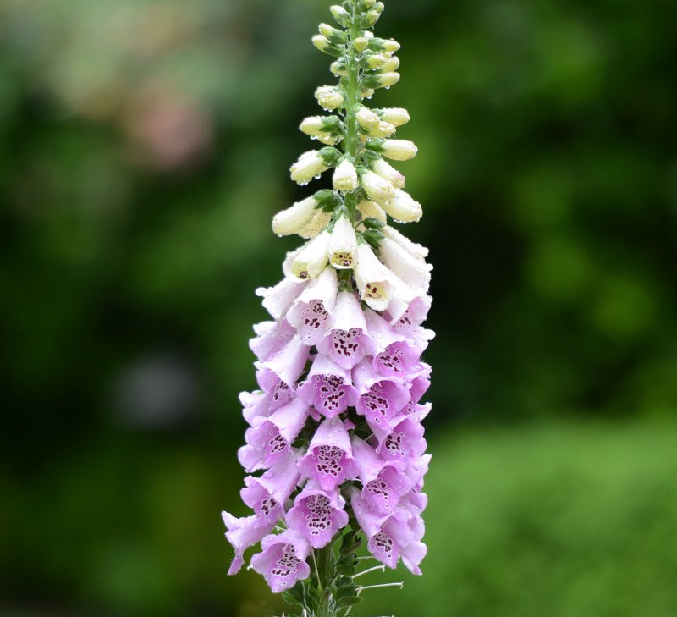
Foxglove Beardtongue
A great bloomer for clay loam in areas with poor drainage.
Use Wildlife: Hummingbirds and bumblebees
Attracts: Hummingbirds
Nectar Source: yes
Value to Beneficial Insects
Special Value to Native Bees

Slide 39
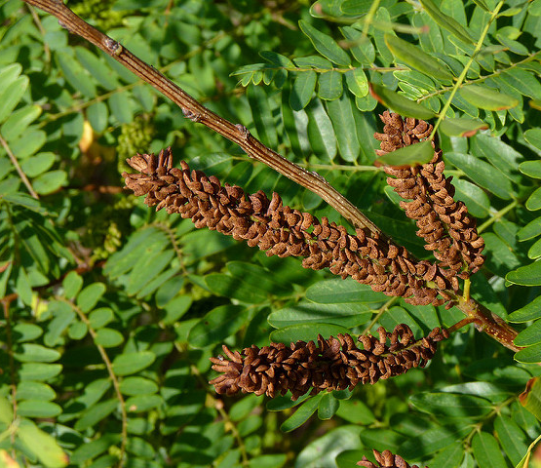
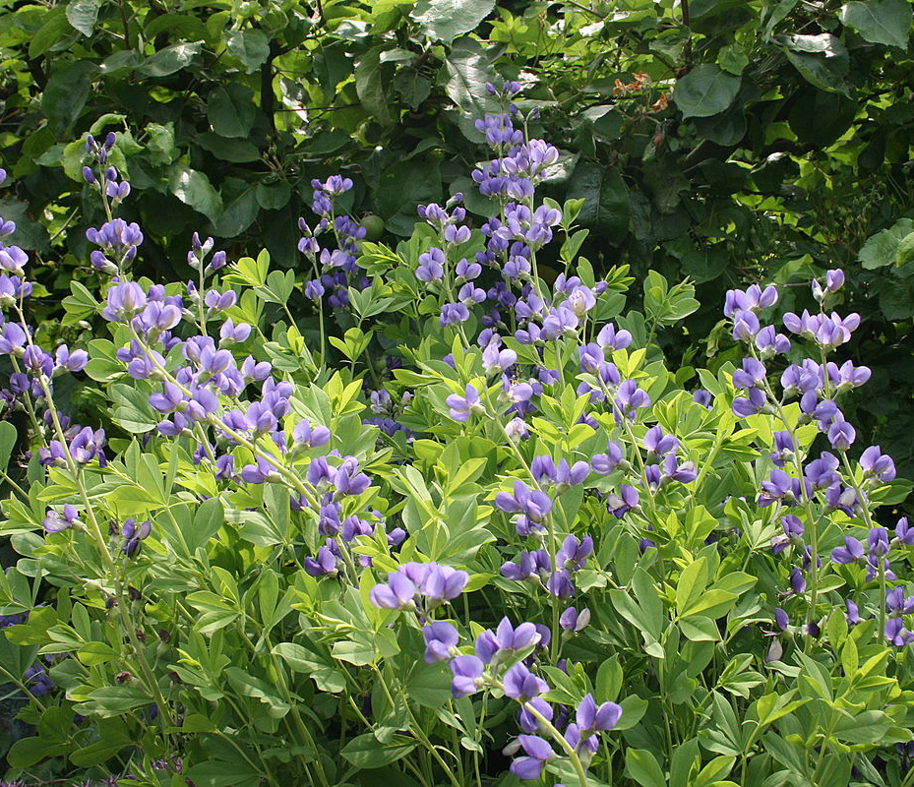
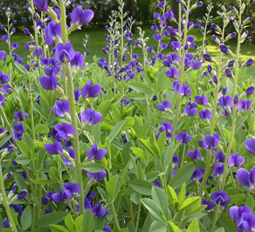
False Indigo Bush
Native Habitat: Stream & pond edges; gravel bars, open woods; roadsides, canyons.
Soil Description: Moist soils to dry sands. pH adaptable. Sandy, Sandy Loam, Medium Loam, Clay Loam, Clay, Acid-based, Calcareous.
Use Wildlife: Nectar-bees, Nectar-butterflies, Nectar-insects, Browse.
Attracts: Butterflies
Special Value to Native Bees
This Photo by Unknown Author is licensed under CC BY-SA
This Photo by Unknown Author is licensed under CC BY-ND

Slide 40
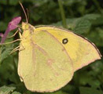
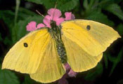
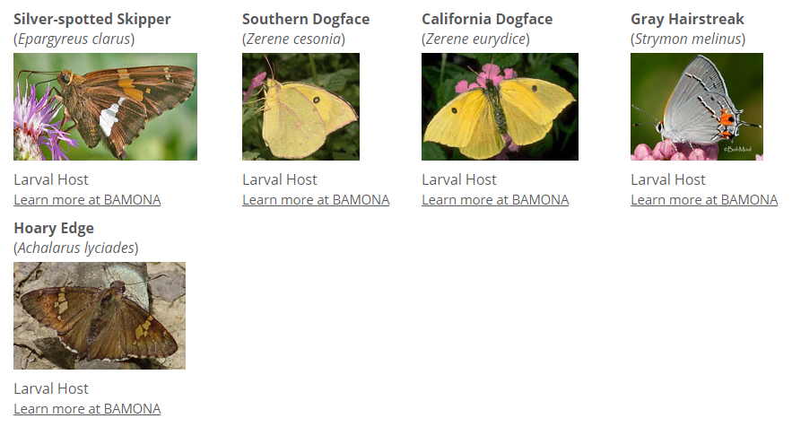
False Indigo Bush

Slide 41
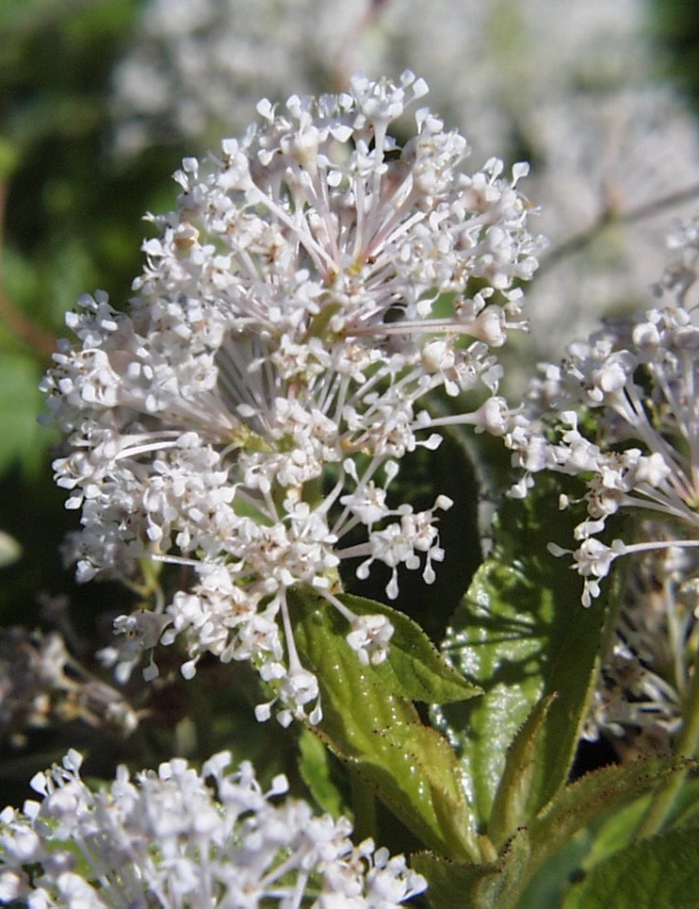
New Jersey Tee
Native Habitat: Open, deciduous woods; woodland edges; oak savannas; mesic or dry prairies; roadsides
Soil Description: Well-drained, mesic sand, loam, or limey soils. Sandy, Sandy Loam, Medium Loam, Limestone-based
Conditions Comments: This extremely adaptable species can a lot.
Use Wildlife: Butterflies use flowers. Turkeys and quail consume seeds.
Nectar Source: yes
Value to Beneficial Insects
Special Value to Native Bees
This Photo by Unknown Author is licensed under CC BY-SA
This Photo by Unknown Author is licensed under CC BY-SA

Slide 42
New Jersey Tee

Slide 43
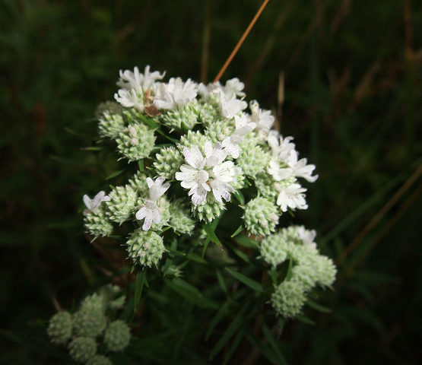
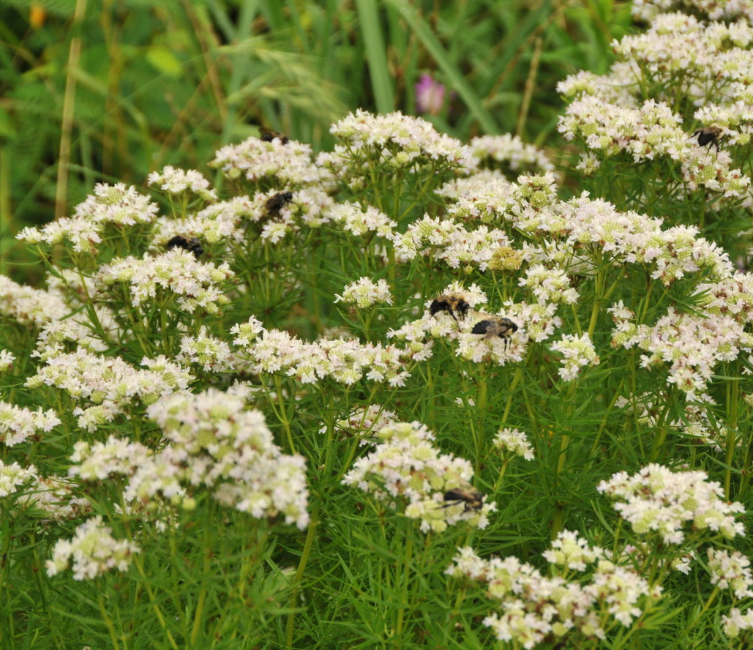
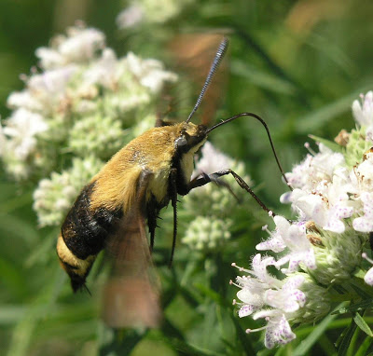
Narrowleaf Mountainmint
Native Habitat: Upland prairies; dry, rocky, open woods; low, wet areas as well as fast-draining Post Oak woods and pine barrens
Soil Description: Various moist to dry soils
Use Wildlife: Bees and butterflies use flowers. Deer eat leaves. Numerous animals eat seeds.
Use Food: Dried leaves used as flavoring and in teas.
Use Other: Rub leaves on skin to repel mosquitoes
Attracts: Birds , Butterflies
Nectar Source: yes
Value to Beneficial Insects, native bees, bumble bees, honey bees, and supports conservation biological control
This Photo by Unknown Author is licensed under CC BY-SA
This Photo by Unknown Author is licensed under CC BY-SA-NC
This Photo by Unknown Author is licensed under CC BY-SA-NC

Slide 44
Grow Natives!
www.growindiananatives.org

