Slide 1

HCSWCD Introduction to Grants
Amy Shankland, GPC
Grants Avenue, LLC
How to Be Grant-Ready, Find Opportunities, and Write Applications That Get Funded!

Slide 2

Today’s Schedule
  Grant Readiness and How to Find Grants
  Application Basics, Group Work, Q&A

Slide 3

What Does “Grant Ready” Mean?
Are you registered on various sites?
  Dun & Bradstreet, SAM (federal government), appropriate online State of Indiana system
Internal capacity
  SWOT analysis, programming, grant management (financial, reporting, etc.)

Slide 4

What Does “Grant Ready” Mean?
Internal controls and policies
  Example: Equipment Record spreadsheets (handout)
What are your goals?
  Operating?
  Programming?
  Equipment?

Slide 5
What Does “Grant Ready” Mean?
Grant Readiness Assessment Tool and Checklist (handout):
  http://www.dhleonardconsulting.com/wp-content/uploads/2014/11/Grant-Readiness-Assessment-Documentation-Annual-Check-Up-Tool.pdf

Slide 6

How to Find Grant Opportunities
Online sites/software most efficient
  Foundation Directory Online
  eCivis
  Grant Station ☺ (demo, GPA)
  grants.gov
  State of Indiana
  Local resources- ex. community foundations
  Google

Slide 7

Grant Professionals Association

Slide 8

What if I want to learn more after today?
    Indiana Youth
    Institute
    Annual conference every December in Indianapolis
    Annual trainings at locations around the state each spring

Slide 9

IUPUI Center on Philanthropy
Two day grant course ($$)

Slide 10
United Way
Grant Proposal Writing for Beginners

Slide 11

Subscribe to this. Now.
    www.charitableadvisors.com

Slide 12
Top Five Grant Proposal Writing Tips
1. Read the grant guidelines slowly and carefully and highlight important details
  Font, word and character limits, margins, what they like to fund and what they WON’T fund, match requirements, reporting requirements, deadlines
  Meet with program officer if possible
    Funders don’t give TO you, they give THROUGH you

Slide 13
Top Five Grant Proposal Writing Tips
2. Have a grant application kick-off meeting and carefully plan project for application details
  Grant professional
  Program director
  Financial representative (for correct financial reporting/accountability)

Slide 14
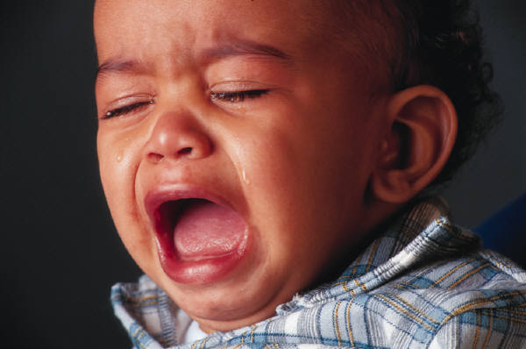
Top Five Grant Proposal Writing Tips
Don’t submit at the last minute
  DO NOT submit
  on deadline day or
  this will be you.

Slide 15

Top Five Grant Proposal Writing Tips
Have another person proofread the application
  Preferably someone outside of the project

Slide 16

Top Five Grant Proposal Writing Tips
5. Pay attention to your budget!
  It tells the whole story, often the first thing a reviewer turns to

Slide 17
Typical grant proposal and letter of intent components
  Background of organization
  Need statement
  Goals, objective, inputs, outputs, outcomes
  Program information
  Evaluation
  Partners and Sustainability

Slide 18

Background of organization
Mission, vision
History, partners
Major accomplishments
Current activities
AVOID JARGON

Slide 19

Need Statement
LOCAL or REGIONAL info
  Statewide if all else fails
Tell a story
  Reviewers want facts, stats…
  But they’re also human!

Slide 20
Goal, Objectives, Inputs
Goal – broad statement of overall goal for the project
Objectives – SMART steps showing how you’ll reach the goal
Inputs – elements needed for the project such as staff, equipment, time/in-kind work, etc.

Slide 21

Outputs and Outcomes
Outputs – short-term results of the project showing goal will (hopefully) be obtained
Outcomes – long-term, broad results of the project reaching beyond initial site
Chocolate chip cookie example!

Slide 22

Program Information
Show and tell time!
Explain how you’ll meet the needs presented
Describe plan and project
Show numbers
Timeline

Slide 23

Evaluation
Quantitative AND Qualitative
  Probably the toughest part of
  any grant application
  Surveys, pictures,
  measurements
  Outside evaluator?

Slide 24
Partners and Sustainability
Who are your partners and how will they contribute to the project
  Letters of collaboration vs. support – make certain you have TRUE partners
Sustainability = how will you fund this project after grant funding ends
  Do not say “we’ll get another grant!”
  Good fundraising plan/mix

Slide 25

Practice Time – Group Work
Need Statement
  10 minutes
Evaluation
  10 minutes

Slide 26

Questions? Comments?
What was challenging about this
exercise?
  Why?
  How can we overcome this
  challenge?

Slide 27

Questions After Today?
Amy Shankland, GPC
Grants Avenue, LLC
317-750-1204
grantsavenue@gmail.com

